Slide 1
Designing Friendship
Tools to growing meaningful friendships in online games
Link to full talk video: http://www.gdcvault.com/play/1024955/Game-Design-Patterns-for-Building

Slide 2
Daniel Cook Game designer for 20+ years

Slide 3

Notes:
Design writings on LostGarden.com

Slide 4
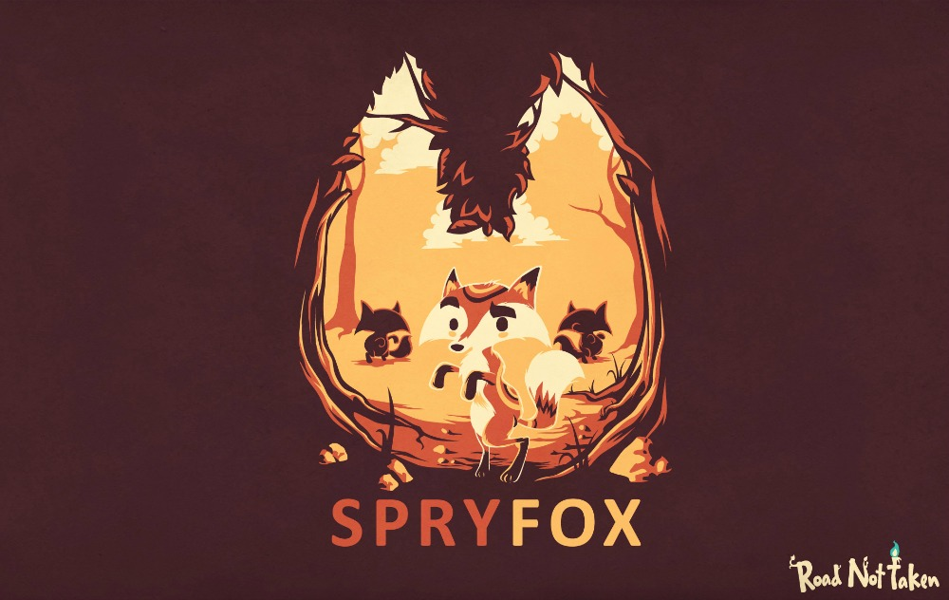
Notes:
Chief Creative Officer at Spry Fox, a small game studio.
Mostly as a lead designer or creative director
Co-founder of Spry Fox
Design for Triple Town, Panda Poet, Road Not Taken, Alphabear, Steambirds, Realm of the Mad God, Beartopia, Bunni and Tyrian.

Slide 5
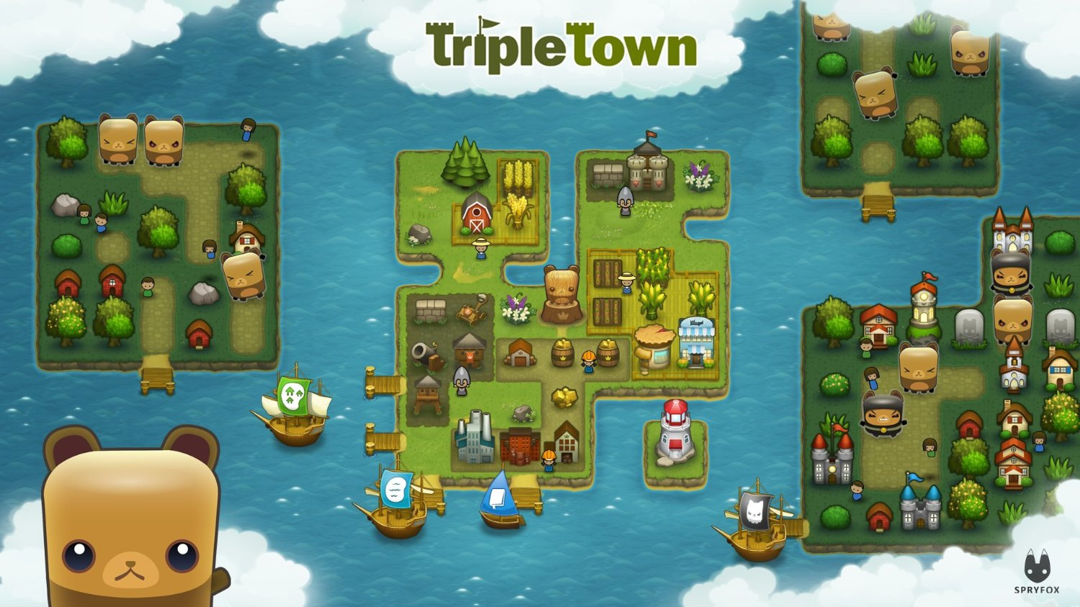
Notes:
I’ve worked on a bunch of small tight evergreen single player games. Triple Town was the forefather of merge genre.

Slide 6
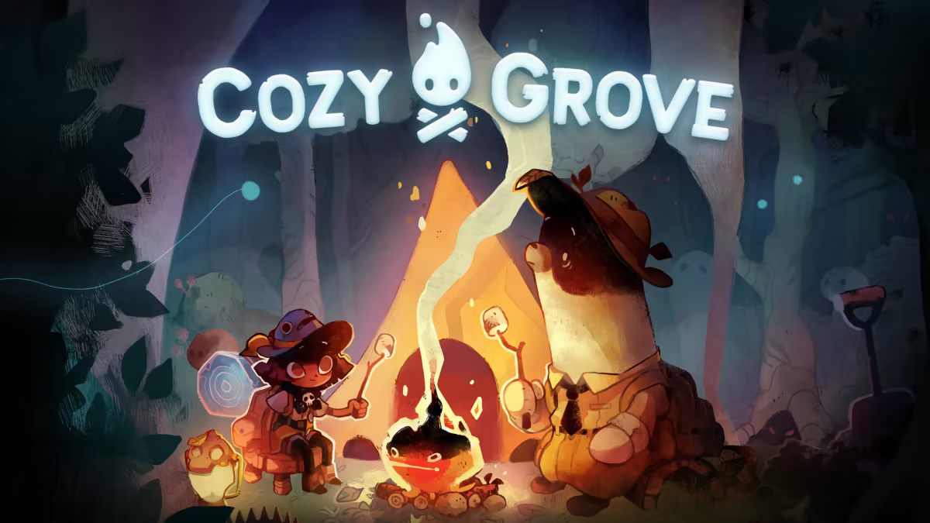
Notes:
Done a bunch of work in cozy games. Road Not Taken, Cozy Grove.
Paper on cozy games: https://projecthorseshoe.com/reports/featured/ph17r3.htm#:~:text=Coziness%20itself%20refers%20to%20how,no%20impending%20loss%20or%20threat.

Slide 7
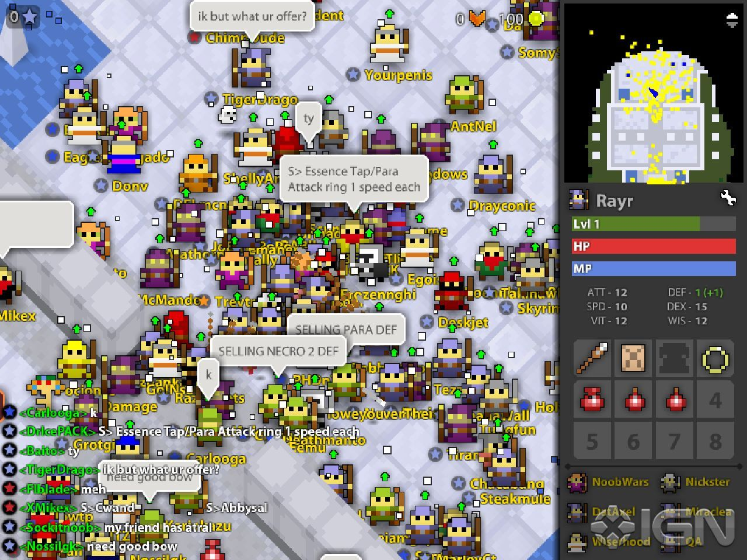
Notes:
But then I started getting into designing multiplayer games. It is my current passion.
This is Realm of the Mad God. Flash MMO with millions of players

Slide 8
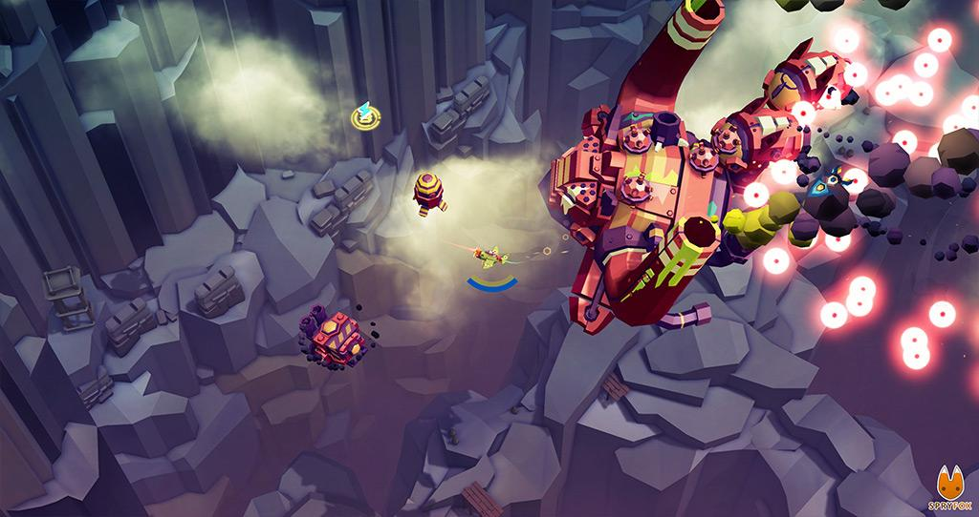
Notes:
I’ve continued this trend. Here’s Steambirds, our latest MMO. We also recently released Beartopia, a VR MMO

Slide 9
Happiness
Notes:
I don’t build game because I love games. Games are just a tool.
I build games because I want to bring happiness to the world.
So I went looking for things that improve happiness.

Slide 10
A small number of
deep friendships leads to greater happiness in life
Notes:
One of the biggest drivers of thriving.
Most people only have 5 to 7 friends

Slide 11

Large numbers of
shallow, status-based relationships leads to
increased depression
“Close Friendship Strength and Broader Peer Group Desirability as Differential Predictors of Adult Mental Health”, Narr, Allen, Tan, Loeb
Notes:
The flip side
This findings are especially true with teens.

Slide 12
So...how can online games create meaningful friendships?

Slide 13
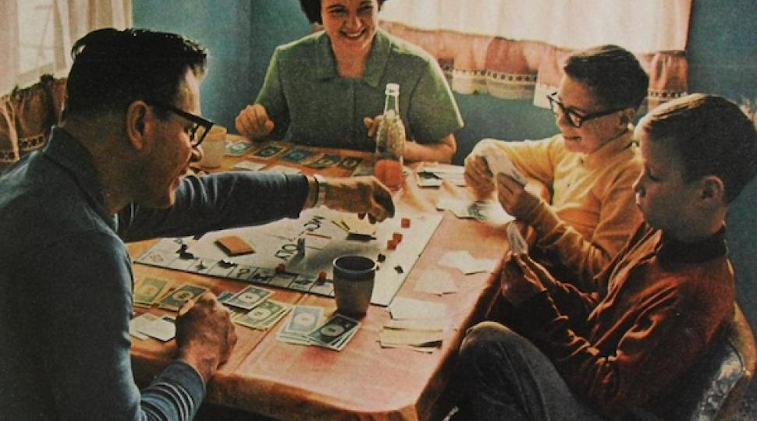
The Fantasy
Notes:
We design a many games as if they can use the naive social structures that exist in the real world. Many of our game rules assume the polite face to face interactions you might get in a game with family or friends will be the same for online gaming.
This is a high bandwidth, high trust environment.

Slide 14

The Reality
Notes:
Instead we interact mostly with strangers, mediated through the computer.
This is a low trust, low bandwidth environment.

Slide 15
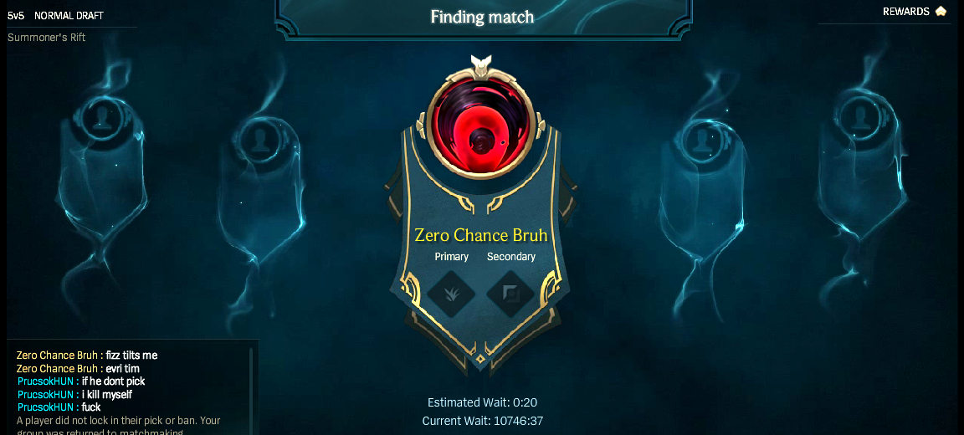
Match-based systems
create throwaway relationships
Notes:
Which leads to a lot of toxic behavior. In Match-based systems, stranger fight. And when the match ends, you never see one another again. There’s not chance to become friends.

Slide 16
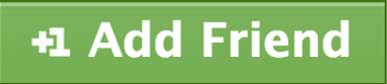
Viral systems turn friendship into an dehumanized marketing resource
Notes:
You click a friend button to earn a currency. A user count ticks up somewhere. Your ‘friend’ is just are a cog in a marketing machine.

Slide 17
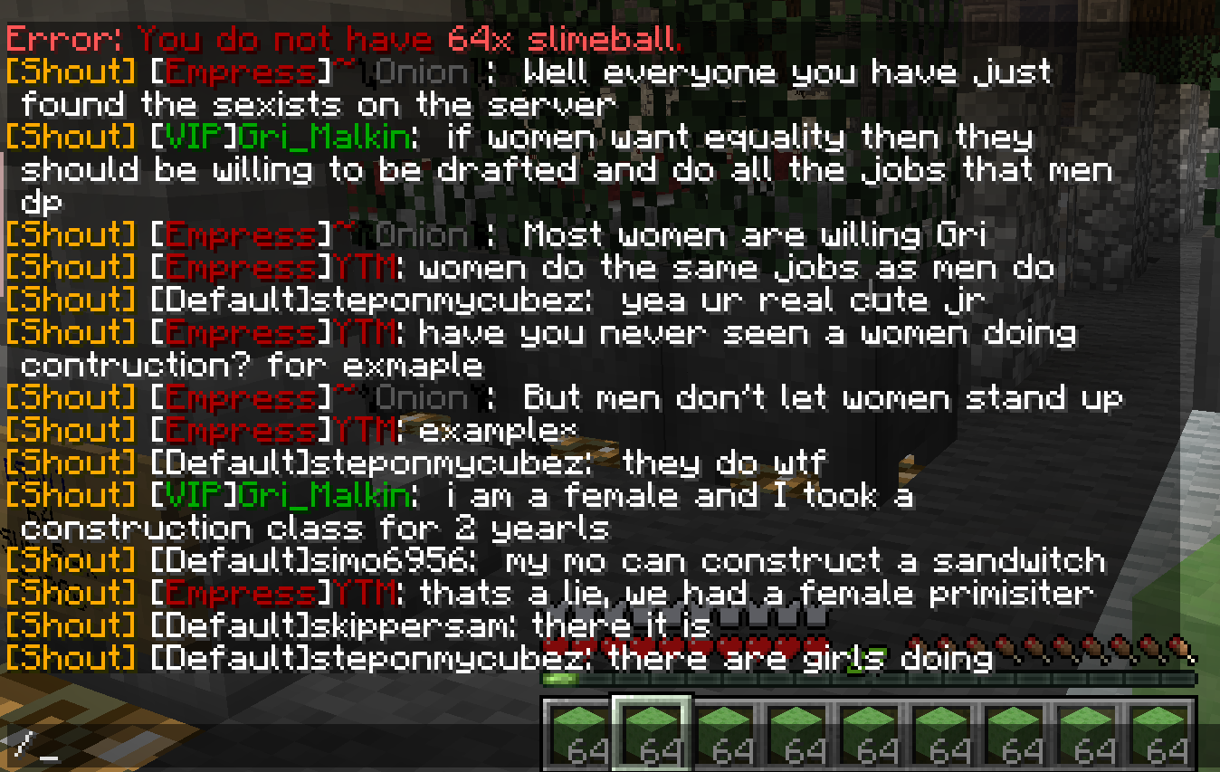
Restricted or unsafe chats
kills deep relationships
Notes:
In some games you aren’t allowed to chat. Those other players could be bots for all you know.
In other games, you don’t bother with chat. Since you don’t want hate spewed at you. In either case, you make no friends.

Slide 18
Can we do better?
Is there a framework for building better friendships?
Notes:
There’s a huge opportunity here. Games absolutely build friendships. But they have a lot of really stupid practices that actively hurt friendship formation. How can we design games that are better at building friendships?
How do we build games that help humans be their best possible self?

Slide 19


Notes:
If only someone had studied this topic…
1950s, Schachter and Festinger. Giants in the field of social psychology.
Broke away from pure behaviorism and started looking at how people interact in groups.
We owe the term Cognitive dissonance to Festinger. Schachter went on to create his two factor theory of emotion.
4200 results on just social proximity (propinquity) and friendship since 2010. Still a broadly used and studied concept.

Slide 20
A proven model for friendship formation

Slide 21
The Laws of Friendship Formation
Proximity
Similarity
Reciprocity
Disclosure
Notes:
Here are the 3 factors you need for friendship formation. If you don’t have them in your game, deep friendships don’t form. We’ll also talk about the two accelerants: Similarity, Intensity
We are going to go through each of these. What they are. And examples of how to build them into your game.

Slide 22
1. Proximity
Propinquity: Social distance

Slide 23
Repeat, Serendipitous Interactions
YO! Mary!
Hi Jill!
Notes:
Density: Intentionally design for concurrent density, not physical space.

Slide 24
Repeat, Serendipitous Interactions
Jill?!
Mary. Again.
Notes:
Players need to bump into one another multiple times. Once is not enough.

Slide 25
Density
It is too crowded!
Mary’s here!
I have no friends
Notes:
Density: Intentionally design for concurrent density, not physical space.
MMO’s have a problem with density. Often we say “Let’s make an infinite world” and as a result you are creating very low density. Fixed number of people / a large area = low density.
There are issues with high density as well. Past Dunbar’s number (80 to 150), people don’t have enough mental resources to maintain meaningful relationships. Those extra people start being treated in a disposable fashion.

Slide 26
This is a Logistics Challenge
Notes:
Problem of one sort (Social Psychology) transforms into the problem of another sort (Logistics)

Slide 27
Example of logistics thinking
Why not just play with friends?

Slide 28
Concurrency Ratios
MMO: 10:1
Online Console Service (like Xbox Live): 25:1
Individual Console game: 150:1
Web game: 250:1
Notes:
Games have a property known as the concurrency ratio. This is the number of monthly active players divided by the number of current online players.
In the best case scenario, maybe 1/10th of your players are online at any time.

Slide 29
Your Friends Aren’t Online
Concurrency of 25:1 means…
if you have 10 friends…
33% chance 1 friend is online when you are
Notes:
This means your friends probably aren’t around.
1- (24/25)^25 = 64%
1- (24/25)^10 = 33%

Slide 30
Tapping Friend Networks
Transfer existing friends to a new social space?
Yes! But expensive! Costs social capital
Need to schedule shared meeting times
Which costs attention and social capital
No serendipity.
Notes:
This means your friends probably aren’t around.
1- (24/25)^25 = 64%
1- (24/25)^10 = 33%

Slide 31

The insight
Old friendships rarely transfer to new contexts due to logistics
Design bomb
So you need to build up new friends out of strangers. UGH!
Notes:
Existing friend networks can transfer, but that is often expensive and rare. You need to spend a lot of social capital to drag a friend into a new social space. And then you need to spend more social capital to schedule shared meeting times.

Slide 32

Design Tools to
Maximize Proximity
Notes:
Theory is great, but practical tools will help you get your job done.

Slide 33
Basic Tools
Persistent Identity: +Repeat Encounters
Events: +Density
Daily Incentives: +Repeat Encounters
Offline Communities: +Repeat Encounters

Slide 34
Basic Anti-Patterns
Anonymous players
Huge, empty areas
Many gameplay modes
Separating player by skill

Slide 35
The Big Anti-Pattern
Matches
Notes:
Come from board games and sports. Super popular. Super problematic.
Just because everyone builds a game with a certain architecture doesn’t mean it is smart.

Slide 36
The Amazing Eternals
“Unfortunately, the game wasn’t attracting players fast enough to support a viable matchmaking player base with the current game design direction, which is the lifeblood of this type of game”
– Digital Extremes
Notes:
Big killer of games while I was at Microsoft as well.

Slide 37
Wait in lobby
Play match
Bored!
Match Maker
Notes:
Nothing more density killing than a game that is about waiting in the lobby.

Slide 38
The cost of this hoary old pattern
Works only with mega hits
High churn due to matchmaking queues
Low repeat interactions

Slide 39
We can design Better
Notes:
Match-based games are a weak friendship design

Slide 40
Pattern: Rooms!
Density Management
Repeat Encounters
Low wait times
Notes:
Here’s an alternative patterns (I call them Rooms, others calls them Spaces)

Slide 41
N slots
in Room
Join
in Progress
Leave
in Progress
Notes:
Big benefit: There’s no waiting.
Downside is that there no starting and stopping of a match, so you have to give up a lot of the pacing mechanisms associated with a match
(Consider opt-in goals that operate per person or per small group. One goal completing doesn’t bring the room to a halt. A match is just a room with 1 shared goal)

Slide 42
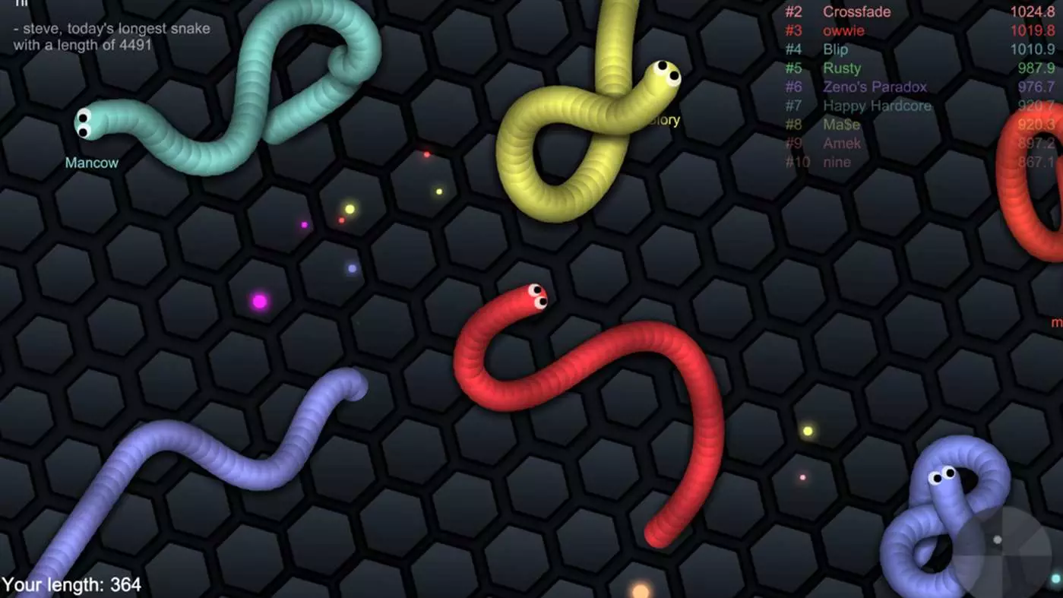
slither.io
Notes:
slither.io.
No matchmaking wait.
Time to get into a game including loading the entire game: 6 seconds.

Slide 43

Pattern: Active Waiting Rooms
Notes:
Let’s look at how GuildWars II extends the basic room pattern into a new pattern: Active Waiting Rooms

Slide 44
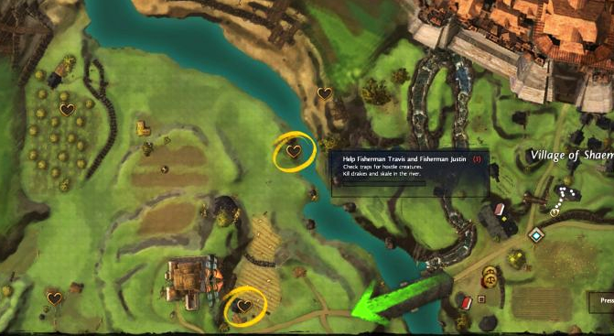
Room with single player quests
Notes:
You pop into a room. And then you are prompted to do these little single player side quests. This keeps you busy and entertained even when there aren’t other people around.

Slide 45
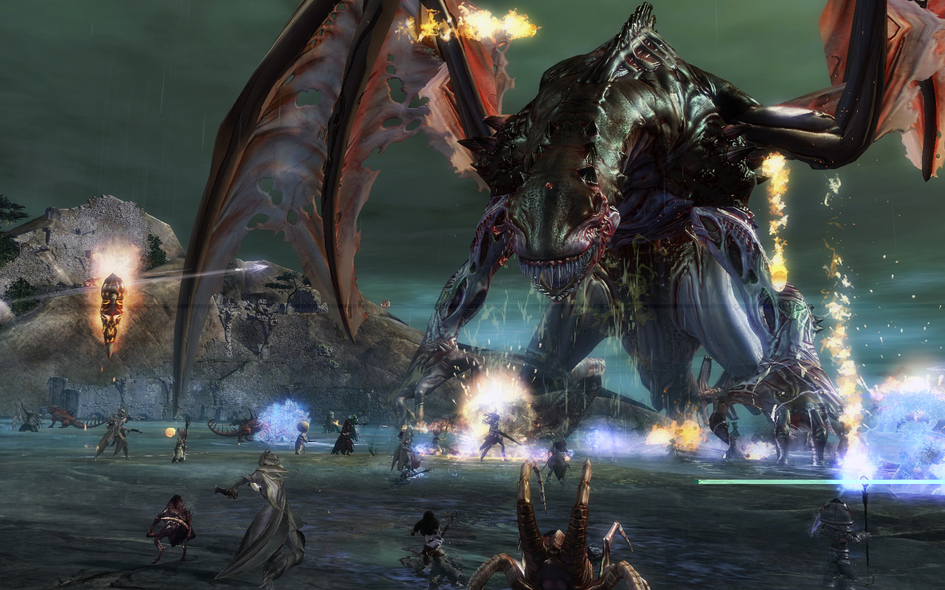
Public Event
Notes:
But once you get enough people, a public event occurs. Now you have the option to do a more communal quests with a higher density of players, plus shared goals for the group.
The public events in Destiny 2 have a similar vibe

Slide 46
Event
Prevents premature leaving
Maximizes ideal density (+Serendipity)
Notes:
Summary of that example
Players in matchmaking queues leave
Instead immediately put them in a game room
Keep them occupied with 1 to N player activities
Once critical player count reached, trigger main events

Slide 47
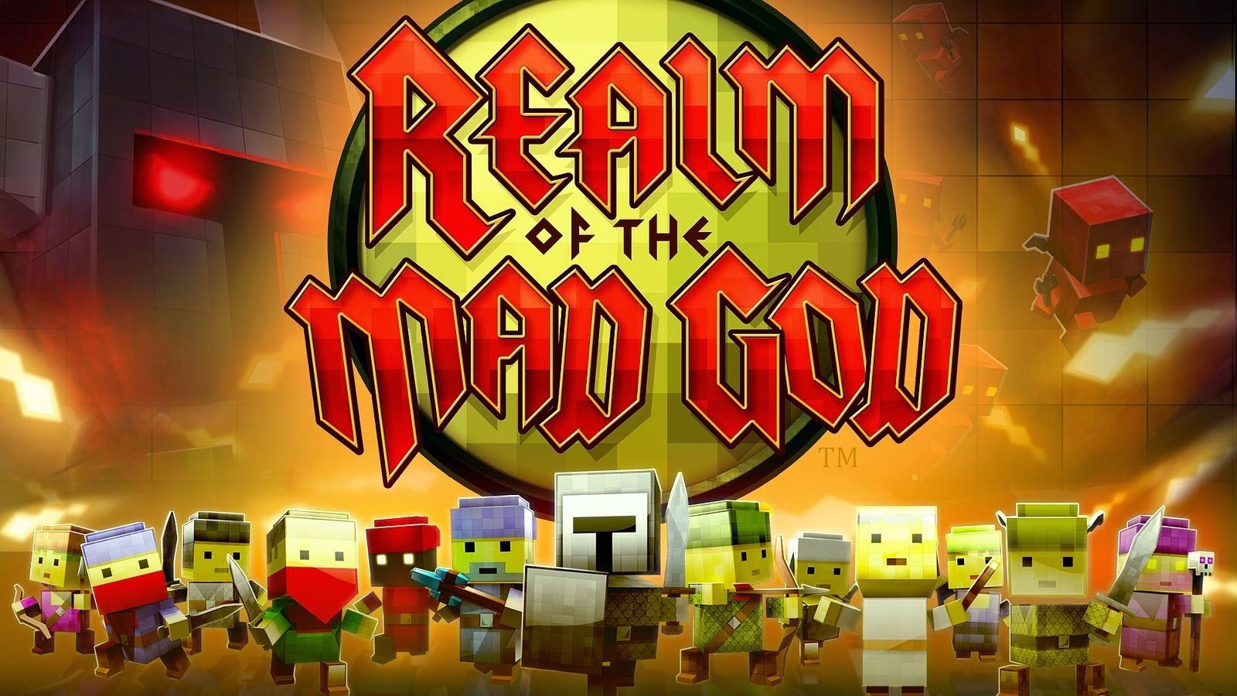
Pattern: Elastic Instancing of Rooms
Notes:
How do you manage player density? Load balancing for density.

Slide 48
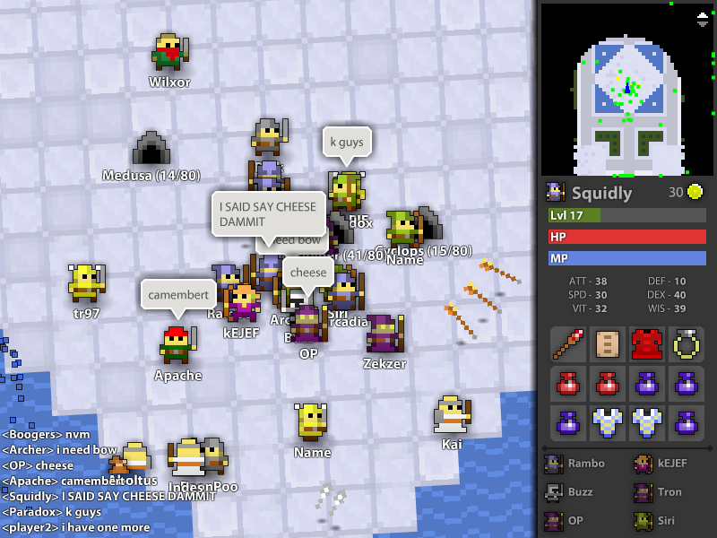
Notes:
Hard to see with all the people running around, but in the hub of the game, you can take portals into instances of the main world.
We knew how the concurrent player population, how many people were online. And we knew we wanted to have around 10 to 80 players in each.
If they got over crowded, we could add more.

Slide 49
Hub
Instances
Ideal Gameplay Density
+Serendipity
Social space
+Serendipity
Notes:
Summary of that example
Players in matchmaking queues leave
Instead immediately put them in a game room
Keep them occupied with 1 to N player activities
Once critical player count reached, trigger main events

Slide 50
Concurrent Players
# of Rooms
Ideal Players per Room
Notes:
Create number of instanced shards to maximize player density
Concurrent = Number of concurrent players
Density = Desired number of players per instance
Slop = Slop slots. Slop is a set of slots that are usually kept empty but allow for friend invites and other intentional joining of a known room. They lubricate the logistics.
Rooms = Concurrent / (Density + Slop)

Slide 51
Smarty pants question from the crowd
What happens when population shrinks?

Slide 52
Pattern: Garbage Collection of Instances
In Realm of the Mad God
Players ‘beat’ instanced servers
Those servers go away
Don’t create new instances
Notes:
This patterns lets you get rid of extra rooms so you can maintain your ideal density.

Slide 53
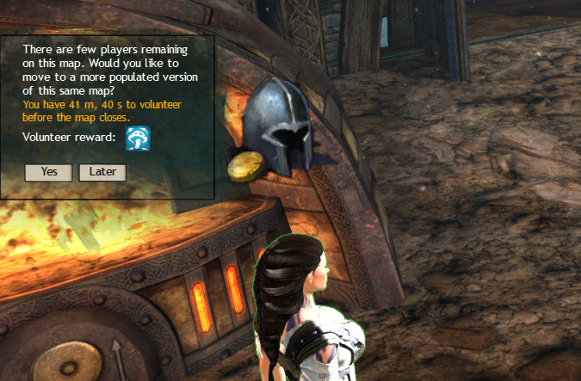
Pattern: Voluntary Migration
Guild Wars 2
Notes:
If server population is low
Bribe players to leave server

Slide 54
Pattern: Involuntary Migration
In Guild Wars 2
If you ignore the offers…
You just get kicked out.
Notes:
If that fails, kick them automatically

Slide 55
Maximizing Repeat Interactions
Notes:
These are patterns for maximizing density?
Biggest single factor in friend creation

Slide 56
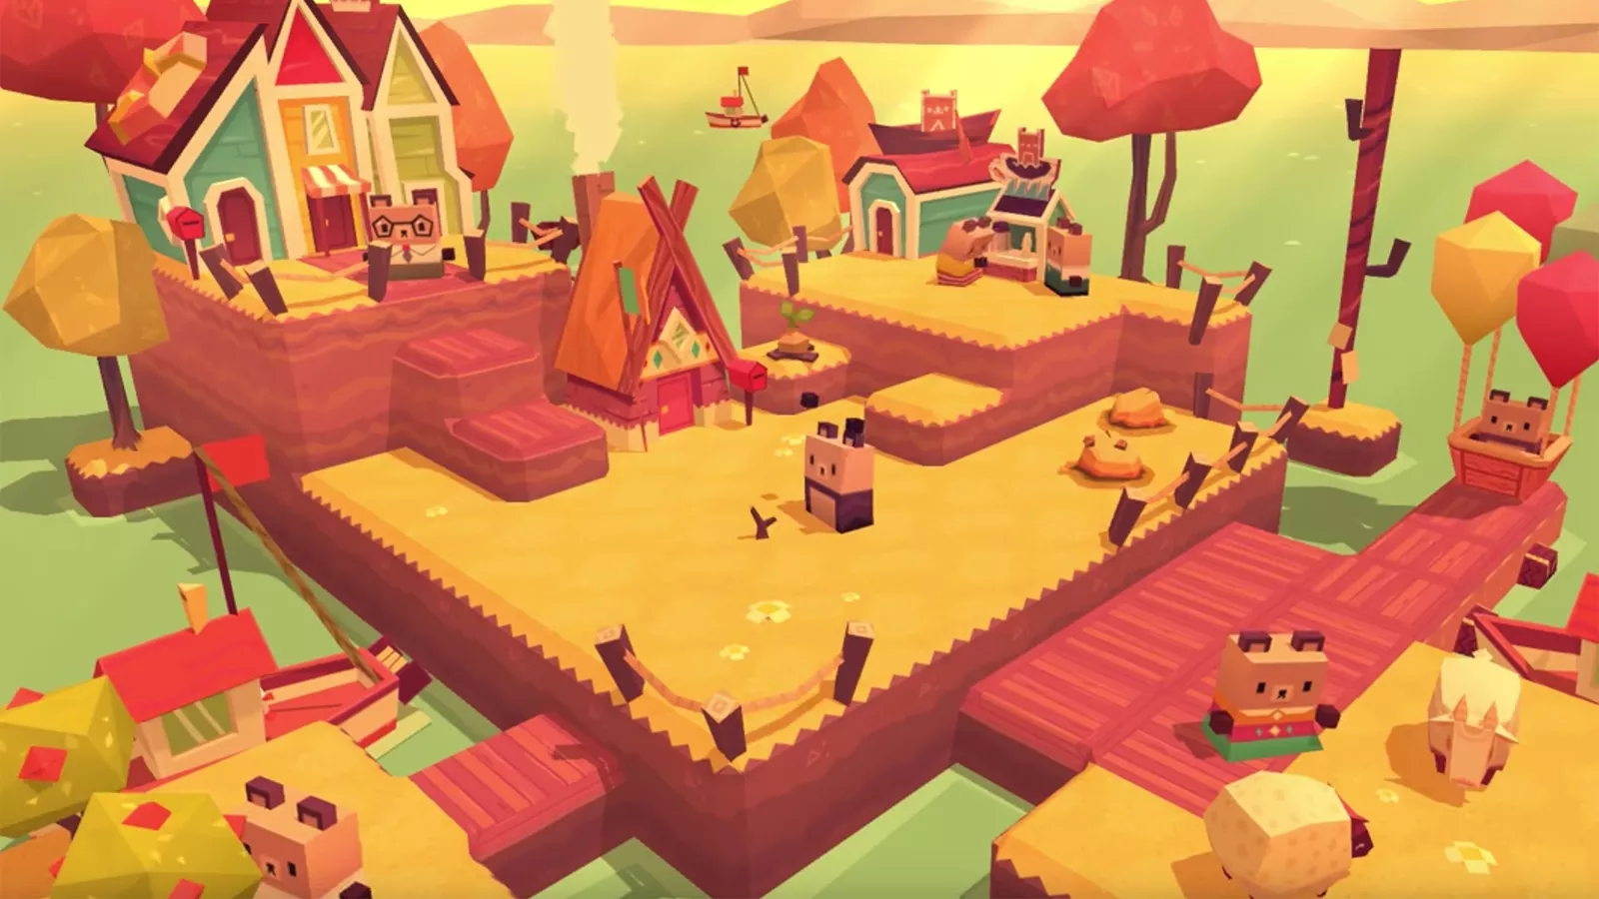
Pattern: Preserve Cohorts
Beartopia
Notes:
Beartopia, MMO by Spry Fox, creates villages of about 40 people. And tries to do everything possible to keep those people together for months.

Slide 57
Failing Village
Thriving Village
Backfill with new players
Migrate
Clean up inactive
players
Notes:
Summary of that example
On starting the game players are funneled into an existing cohort with spare slots
If there aren’t enough villages available a new cohort is created
We clean up inactive players and put them into a ‘rest’ state, opening up slots.
If a cohort is below a number of players, we either select it for backfilling in order to create a high density cohort. Or we migrate the low population cohort to another cohort using voluntary or involuntary game mechanisms.
Whenever migration occurs, we try to keep groups together. We avoid spreading them randomly across multiple cohorts.

Slide 58
Key lesson
To maximize repeat interaction,
try to keep the cohort together
Notes:
This is one of the biggest failing of modern onlines.
Guild Wars 2 put you in other servers based off who you are friends with.
FPS games sometimes put you in another match with the same team.

Slide 59
All tools
Cohort-based placement: Keep friend groups together
Elastic instancing: Only create villages that hit max density
Garbage Collection: Villagers and villages ascend
Idle detection: Frees spots if people go idle
Backfill with new or migrating users
Voluntary migration: If low density
Forced migration: If players don’t take rewards
Notes:
Proximity is something you design into the heart of your game. It isn’t an afterthought. It is a huge and essential systems design activity.

Slide 60
All tools
All Load Balancing patterns!
Think of scaling as social design
Cohort-based placement: Keep friend groups together
Elastic instancing: Only create villages that hit max density
Garbage Collection: Villagers and villages ascend
Idle detection: Frees spots if people go idle
Backfill with new or migrating users
Voluntary migration: If low density
Forced migration: If players don’t take rewards
Notes:
Proximity is something you design into the heart of your game. It isn’t an afterthought. It is a huge and essential systems design activity.

Slide 61
2. Similarity
Perception of shared social norms

Slide 62
1. People make friends
with people like them
Notes:
Similarity is how closely we share various aspects of our personality and background with another person. The more similar one person is to another, the more likely a friendship will be initiated.

Slide 63
1. People make friends
with people like them
Shared norms lower cost of social negotiation
Notes:
Shared norms lower cost of social negotiation. So we believe that people like us will become trusted friends more quickly.

Slide 64
2. Similarity is an incredibly strong filter
Notes:
This can be used for good. Or for evil

Slide 65
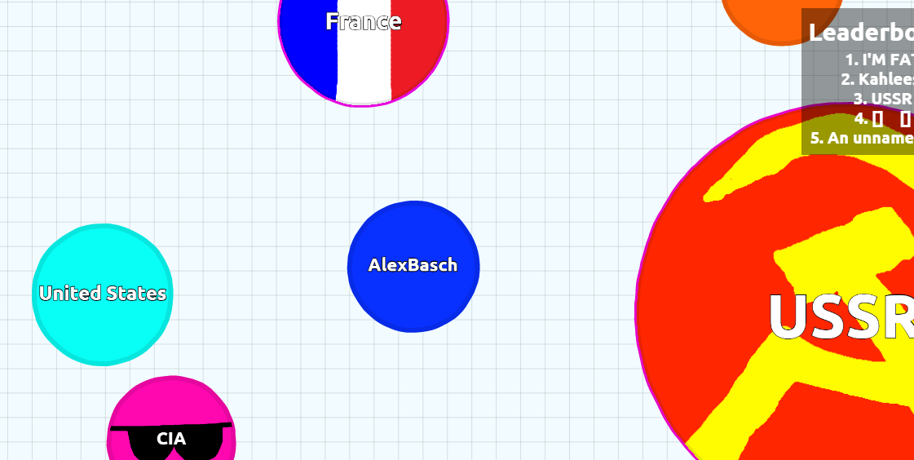
Anti-Pattern: Nationalism
agar.io
Notes:
Naive implementation in Agar.io
Country Flags
Also slurs, website affiliation. Negative. Not just positive

Slide 66
Design Tools to
Benefit from Similarity

Slide 67
Basic Tools
Putting the player in a faction (Horde vs Alliance)
Shared experiences
Shared interests or goals
Notes:
It is your responsibility as a designer to create shared points of identity.

Slide 68
“An individual’s behavior conforms to their digital self-representation”
Yee & Bailenson, Proteus Effect
Notes:
https://vhil.stanford.edu/mm/2007/yee-proteus-effect.pdf

Slide 69
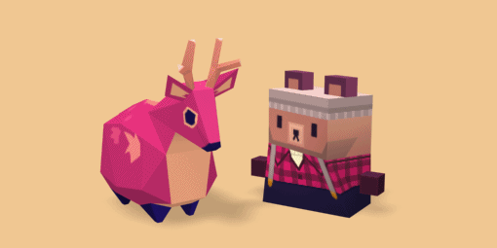
Pattern: Positive Fictional Identities
Beartopia
Create
Pro-social player roles
Positive fictional cultures
That do not reference the real world directly
Assign player to that culture
Notes:
People are nice to one another in Beartopia. We’ve created a welcoming world about working together for the greater good.
It isn’t about selfishly looting the world for personal pleasure. It isn’t about dominating others who resist you. It isn’t about efficiently murdering sub-human Others.
This is a game about immigration and how immigrants are good people trying to build a better life. We casually reference about the social norms we set up in every part of the world and character design. We don’t treat them as something special. They are just the way this world works. And players hear, observe and model that.

Slide 70
Create...
Pro-social player roles Tend & Befriend - Brie Code
Positive fictional cultures
That do not reference the real world directly
Make a better world & Assign player to that culture
Notes:
If is your responsibility as a designer to create shared points of identity.
The Proteus effect means that if we create positive world with positive characters based off positive stereotypes, players will role play those social norms.
People in Beartopia are nice. Because it is a game about being nice to one another.
Age of Conan: People were jerks. Because everything in the game was telling them to be jerks.

Slide 71
3. Reciprocity
Tit for Tat levels up relationships
Notes:
How do you build a relationship once you start bumping into one another?
Next we need systems of reciprocity.

Slide 72
Make a friendly offer...
...Give a positive response
?
Notes:
A reciprocation loop consists of two key parts. Someone makes an offer. And another person gives a positive response.
Exchange doesn’t need to be material
Recognition or Attention
Conversation
Complementary roles

Slide 73
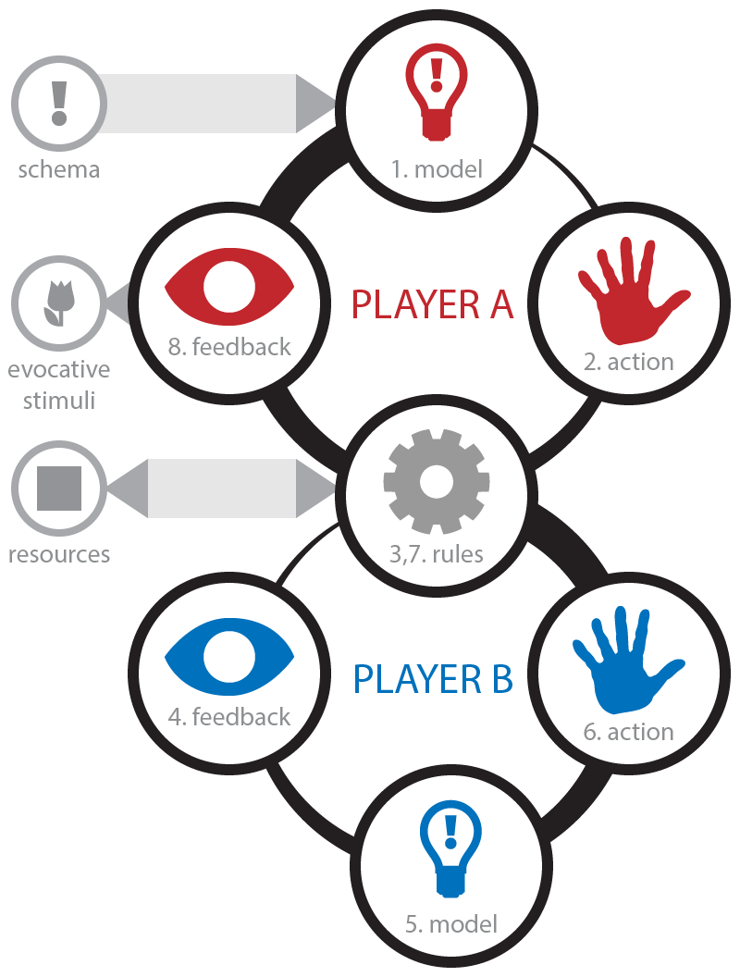
Notes:
Here’s the full loop. There’s more on the website: http://www.lostgarden.com/2012/04/loops-and-arcs.html

Slide 74
2. Each interaction builds Trust
Notes:
Successful interactions build trust.

Slide 75
Trust is another name for Shared Social Norms
Predictable behaviors that facilitate cooperation and coordination
Notes:
If you know how someone will behave, you can do great things together. If you are in a bad situation, you can ask for help. And know that they will understand. And then work together to figure out a solution.
These shared social bonds is the driving source of the great hive mind that is human society. It is is the bedrock of tiny social interactions and culture as a whole.
There’s a massive economic and functional benefit to being in a tribe of close friends that support one another.
You are happier. You die less.

Slide 76
3. Trust grows slowly.
But crashes quickly

Slide 77
4. Trust allows us to increase stakes of each interaction
5-7
Deep friendships are expensive
Notes:
There’s a cost in time, effort and material investment to make friends. This escalates over time.
Most will have 5-7 deep friendship. On average men have 1-2 less. Women on average have 1-2 more.

Slide 78
Groups with trust accomplish more than an individual
Notes:
Why go through all this effort of making friends? The pain of lost trust is very unpleasant. But the practical benefits are immense. Trust allows us to build civilization and culture. It allows us to escape the dismal life of mere individual survival.

Slide 79

People are wired to reciprocate
Notes:
One last note about reciprocation. People want to reciprocate. Giving a gift creates an obligation to respond. A social debt. This can be a form of coercion or dishonest manipulation.

Slide 80
Design Tools to
Maximize Reciprocity

Slide 81
Anti Patterns
Trade scamming / Deceit
Lack of predictability
Extreme power differentials (no mutual need)
Over designing for freeloaders
High initial interaction costs

Slide 82
The Big Anti-Pattern
Early Zero Sum
Notes:
Where we divide up a limited pie. What you get, I don’t get.

Slide 83
Naive Tools
Chat: We can reciprocate socially
Friend lists: We acknowledge a relationship
Shared Goals: We each want the same thing
Guilds: Opt-in tribes with shared norms
Gifting: Giving something to someone
Trade: We each have what the other needs
Notes:
These are the folks design tools we use for designing reciprocation. You put these in place and they work. You’ll get reciprocal relationships. But they are a bit of haphazard approach. They are tools like a knife. You can use them to cut a rope. Or stab someone. And if you throw a bunch of knives into a crowded room, you’ll get a bit of both.

Slide 84
Key lesson
Design systems that intentionally level up Friendship
Notes:
You can think of leveling up friendships.

Slide 85
Friendship Levels
 | Solitary play | Playing alone
 | Parallel play | Playing next to others
 | Ambient Coop | We help others without meaning to
 | Soft Coop | We intentionally benefit others
 | Hard Coop | We must collaborate to progress
 | Friends | We spend time together. Because we find it intrinsically rewarding.
Notes:
You need different reciprocation loops at each level of friendship. Cost escalates. Depth of obligation escalates.
http://news.ku.edu/2018/03/06/study-reveals-number-hours-it-takes-make-friend
“In a new report published in the Journal of Social and Personal Relationships, Associate Professor of Communication Studies Jeffrey Hall found that it takes roughly 50 hours of time together to move from mere acquaintance to casual friend, 90 hours to go from that stage to simple “friend” status and more than 200 hours before you can consider someone your close friend.”

Slide 86
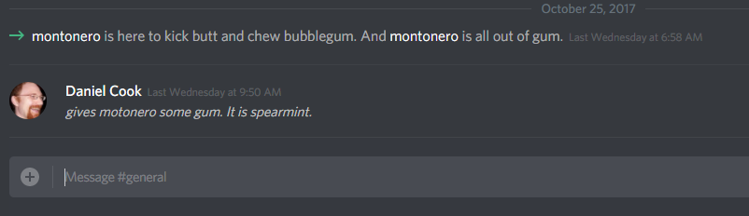
Parallel play: Automate Initial Response
Notes:
Discord automatically introduces players with a pre-written witty intro.
The game can pay the costs of initial interactions

Slide 87
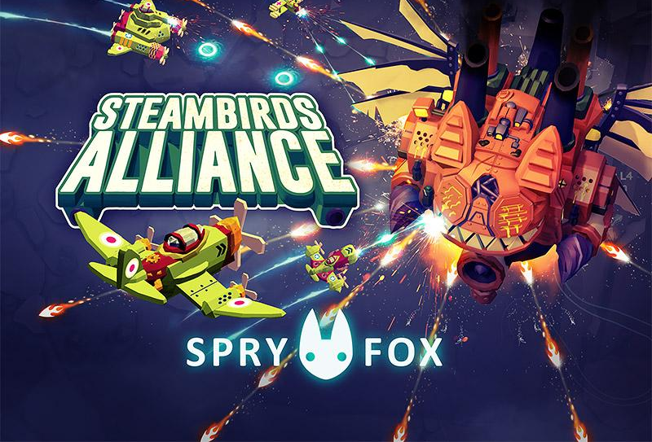
Soft Coop: Non-zero sum Loot
If you kill something on the screen, we both get XP.
Is your game generous if players are doing what you desire?
If a player shoots an enemy, they get loot. No last hits
Notes:
Ambient Coop

Slide 88
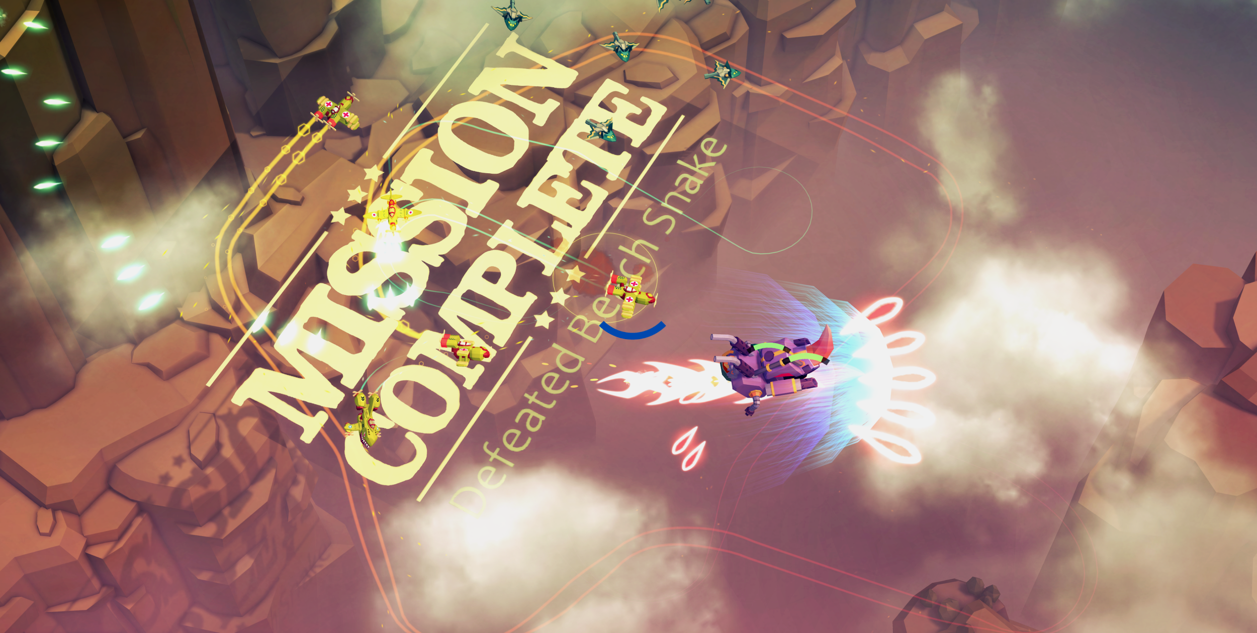
Notes:
If you kill something on the screen, we both get XP.
Is your game generous if players are doing what you desire?
If a player shoots an enemy, they get loot. No last hitting.

Slide 89

Pattern: Non-zero sum guild rewards
I call it the “Super Bowl ring” philosophy...when a team wins the Super Bowl...all the players on the field and the first string, second string all get rings... -M.E. Chung
Notes:
If a guildmate completes an activity, you get a drop.
Automated, so very low cost.
“There’s also sort of the philosophy that we’ve been talking about in the studio, I call it the “Super Bowl ring” philosophy, which is … I don’t know how familiar you are with the NFL, but one of the things that they do, it’s a common gentleman’s agreement practice that when a team wins the Super Bowl, not only do all the players on the field and the first string, second string all get rings, but they also … it’s common practice for them to give it to the general manager, and the owner, and everyone from the staff, to the medical team, to the people who are taking care of the grass on the field.”
http://business.financialpost.com/technology/gaming/destiny-2-social-lead-m-e-chung-on-how-bungie-used-a-super-bowl-ring-philosophy-to-balance-community

Slide 90

Hard Coop: Specialized Roles
Notes:
Now we start moving into hard coop. Where players rely on one another.

Slide 91
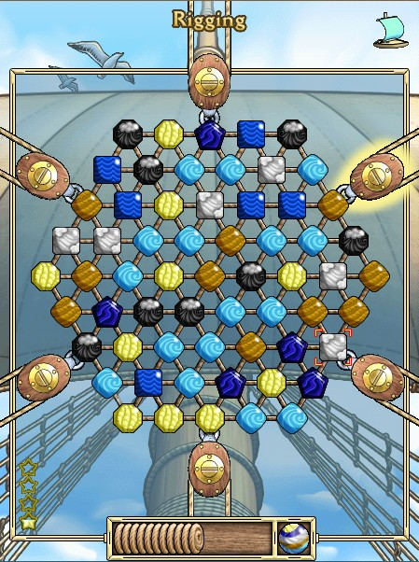
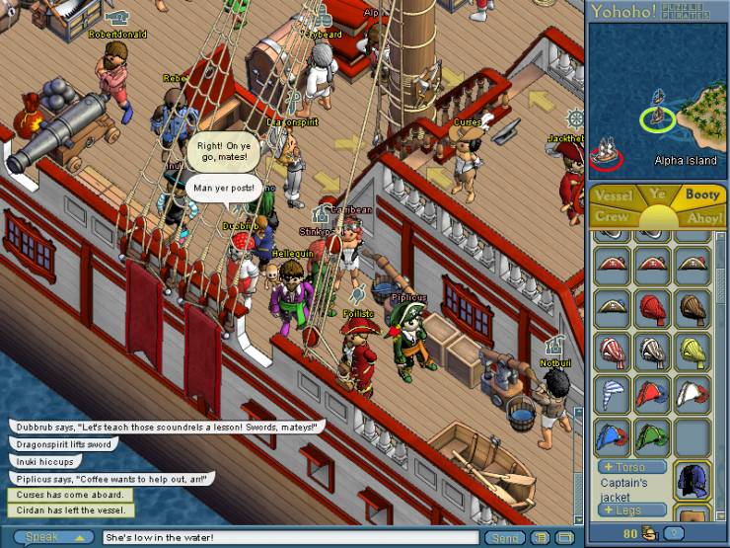
Notes:
You’ve got lots of players on a ship sailing around. And you can play these little mini-games for every task that is needed. This is a similar pattern to the Star Trek game Artemis.

Slide 92
You fail if you don’t work together
Command
Sailing
Rigging
Carpentry
Navigation
Gunnery
Bilge Pumping
Notes:
Players working together on a boat
One handles guns. Another rigging.
Sailing and Rigging increase ship speed and generate movement tokens during sea battle.
Bilge pumping keeps water out o' the ship, and sailing effective.
Carpentry and Patching repair normal wear and tear, as well as sea battle damage, and keeps bilge from rushing into the ship.
Gunnery loads cannons for the commanding officer to fire during sea battle.
Navigation increases the effectiveness of the sailors and allows memorization of league points.
Treasure Haul transfers PoE onto the ship from sunken wreckage in blockades, flotillas and atlantis.
You see this pattern in Artemis, Guns of Icarus and MMO Guild raids.
Players specialize.
Together, they create synergies that make them dramatically more effective.
Designers create challenges that require multiple specialized roles cooperating to overcome.

Slide 93
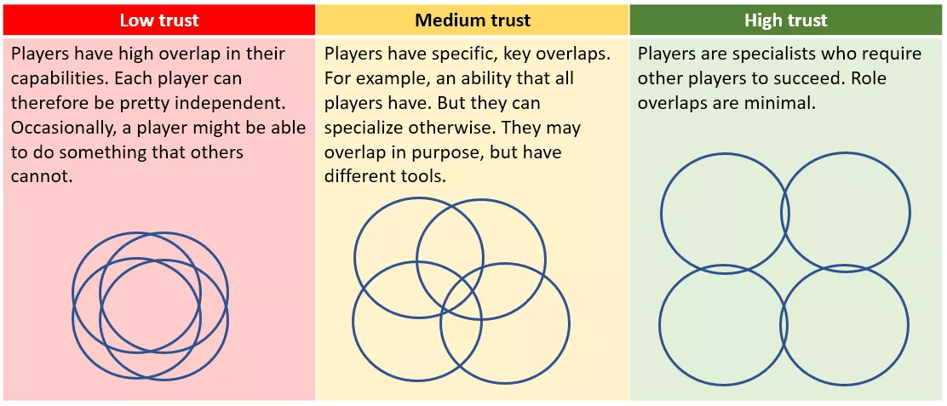
“Spectrum of Trust”, Koster, Cammarata et al. https://www.raphkoster.com/2018/03/16/the-trust-spectrum/
Notes:
Again, you work your way up a ladder of trust. Highly recommend you read
https://www.raphkoster.com/2018/03/16/the-trust-spectrum/

Slide 94
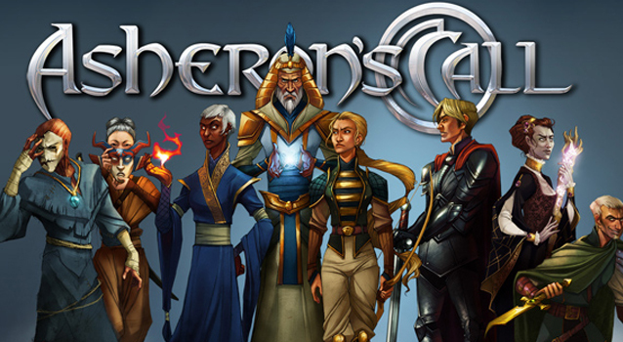
Official Relationships
Notes:
Many games keep relationships unofficial. At best, you might be a friend on a friend’s list.
Asheron’s call made relationships explicitly supported by the game.

Slide 95
Patronage
Overture
Patron
Newbie
Notes:
Encourages high level players to twink and advise new players
Shared XP
Natural hierarchical pyramid and thus group affiliations

Slide 96
Patronage
XP
Patron
Newbie
Notes:
Encourages high level players to twink and advise new players
Shared XP
Natural hierarchical pyramid and thus group affiliations

Slide 97
Patronage
Patron
Patron
Patron
Newbie
Newbie
Newbie
Newbie
Notes:
Official hierarchy. You can encode social structures in game systems. Groups, hierarchies. Systems of government and taxation.

Slide 98
4. Disclosure
Reveal weakness for strongest bonds

Slide 99
In deep relationship: Reciprocation loops change from superficial mirroring to riskier trust building
The key to deep trust: The ability to disclose risky information to a friend without rejection
Notes:
Fast friends protocol
http://tuukkablab.com/?p=168
https://www.ocf.berkeley.edu/~adp/rasclab_v1/ffp.html

Slide 100
Disclosure is risky

Slide 101
But the only way to grow

Slide 102
Personal info triggers nasty reactions
racism
sexism
ageism
classism
height
religion
nationalism
Notes:
Prematurely revealed personal information may be used as a resource to extract value from someone who is not seen as a close trusted friend. Exploiting racism for example is easier when you are dealing with a dehumanized other, especially if it gives you social currency of some sort within an existing community.
Once you are close friends, this form of disclosure is less likely. (The economic reading of why premature disclosure occurs)

Slide 103

Friendship Levels
Solitary play
Parallel play
Ambient Coop
Soft Coop
Hard Coop
Good friends
Premature Disclosure
Opt-in disclosure
Notes:
Before the relationship is ready...
Surface real world similarity
Players fall back on negative stereotypes

Slide 104
Overwatch
“I like to play comp in overwatch but i can't use the voice chat without getting marriage proposals etc. Do you guys have any tips on programs that can change my voice to be alot more masculine?”
Notes:
https://eu.battle.net/forums/en/overwatch/topic/17615434058

Slide 105
Premature disclosure
kills relationship leveling
Trust is lost
Notes:
You’ll never get past those initial encounters. People build up defensive walls and kill the trust formation in the community.

Slide 106
Anti-Patterns
Don’t start with new unsocialized players using
Real name
Voice chat
Real location
If item was purchased with real money

Slide 107
Key lesson
Design a ladder of opt-in intimacy
“Opt-intimacy” - Lisa Brown, Master Game Designer, 2018

Slide 108
 | Solitary play | Identity
 | Parallel play | + Expressive Actions
 | Ambient Coop | + Emotes
 | Soft Coop | + Chat + Blocking
 | Hard Coop | + Group Chat
 | Friends | + Private Spaces
Notes:
Chat is critical. Just open it up at the right time.

Slide 109
Pattern: Cone of Silence
Secrets!
So quiet!
Notes:
Realm of the Mad God
In the Nexus (Hub areas) chat could only be heard by people within a screen width
By clustering closely in an isolated area, players could start adhoc private chats
They could see others walk into the conversation.
Large spaces outside main areas increased chance of privacy.
No special commands required. Emergent privacy

Slide 110
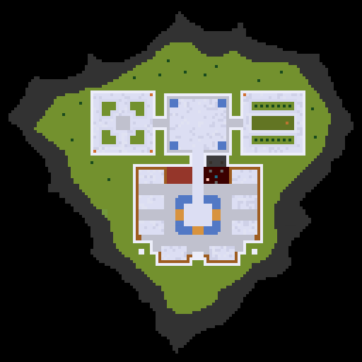
Private areas
Public areas
Notes:
Example of Opt-in
Realm of the Mad God
You could choose to go out into the wilderness.
This led to opt-in privacy

Slide 111
 | Solitary play
 | Parallel play
 | Ambient Coop
 | Soft Coop
 | Hard Coop
 | Friends
Real friends get to skip
Friend invites
Time for privacy
Shared via private chat
Notes:
Nintendo Friend codes: Have a cost.
Use outside channels. Doubles as virality
Make responding costs low
https://www.gamasutra.com/blogs/ConstantinBacioiu/20171121/310012/Post_Mortem_I_thought_I_could_ship_at_least_700_units_to_stay_in_business.php#comments

Slide 112
Limited Social Energy
Dunbar’s layers
Notes:
Friends: Understanding the Power of our Most Important Relationships
by Robin Dunbar
https://www.amazon.com/dp/B08W4XPK7G/

Slide 113
Social Brain Theory
We have big expensive brains!
Why? We spend a lot of energy modeling the state of other minds.
I know that you know that I know.
Allows for highly efficient group coordination
And social learning
Notes:
https://pubmed.ncbi.nlm.nih.gov/19575315/#:~:text=Abstract,their%20unusually%20complex%20social%20systems.
Note: This is one of many competing theories. Lots of evidence supporting food type and foraging habits as having an impact on brain growth. It is very likely a mix of these factors.

Slide 114
Hard limits on number and quality of social connection
Notes:
Why go through all this effort of making friends? The pain of lost trust is very unpleasant. But the practical benefits are immense. Trust allows us to build civilization and culture. It allows us to escape the dismal life of mere individual survival.

Slide 115
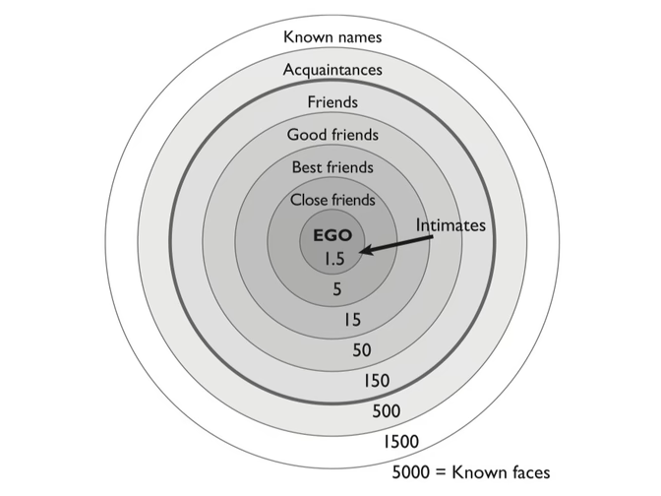
Notes:
The circles of friendship (Courtesy of Little, Brown)

Slide 116
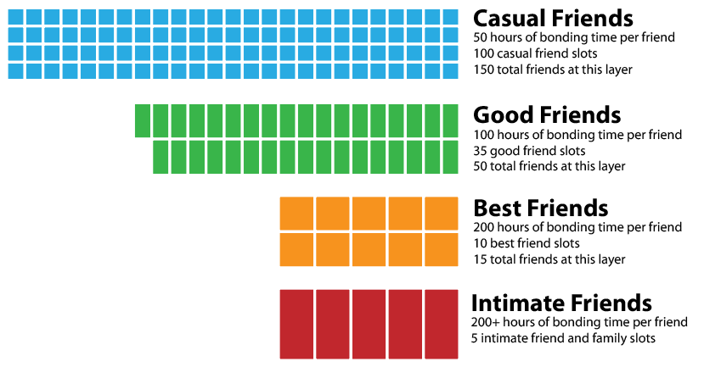
Sympathy Layer
Support Layer
Notes:
Support: People you go to for help.
Sympathy: People you can complain to.

Slide 117
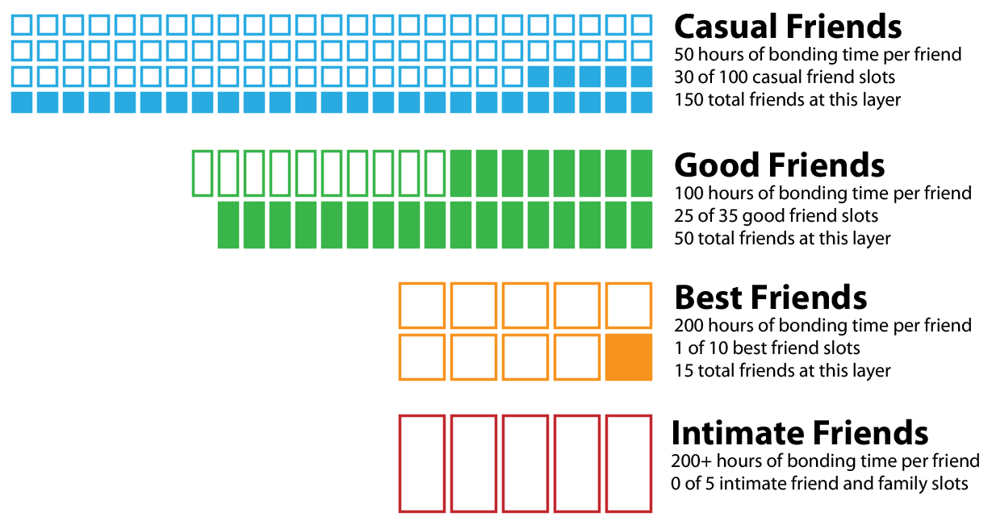
Loneliness is an empty graph

Slide 118
Flood of low quality connections
Social media (following, liking)
Parasocial relationships (Rachel on Friends)
Characterful products (Mr. Clean)
Overtures are not reciprocated meaningfully
Ultimately parasitic social energy drains
Notes:
https://twitter.com/danctheduck/status/1515210653807513600
https://www.psychologytoday.com/us/blog/finding-new-home/202204/why-buying-things-makes-us-feel-less-lonely

Slide 119
Conclusion
Design for friendship formation

Slide 120
 | Proximity | Similarity | Reciprocity | Disclosure
Solitary play
Parallel play
Ambient Coop
Soft Coop
Hard Coop
Friends
Notes:
For each stage: parallel play, soft coop, hard coop, good friends
And for each requirements: proximity, similarity, reciprocity and disclosure

Slide 121
Anti-Pattern
Retrofitting a social architecture is hard
Notes:
You’ll be fighting human nature the whole time. A lot of toxicity in social system occurs because you built the wrong system.
When you build a game that is logistically and architecturally prevents friendships, you have a hard slog ahead.

Slide 122
Key lesson
Design friendship leveling in
from the start. Make it a design pillar.
Notes:
It is the difference between your game being a toxic blight on the world.
And your game bringing happiness to the world.

Slide 123
More info
Game Design Patterns for Building Friendships
https://www.projecthorseshoe.com/reports/featured/ph16r4.htm
Trust Spectrum
https://www.raphkoster.com/2018/03/16/the-trust-spectrum/
2-year google project on trust formation using games
Human-scale Social Systems Design
https://www.projecthorseshoe.com/reports/featured/ph18r8.htm
Notes:
Also
http://www.lostgarden.com/2017/01/game-design-patterns-for-building.html

Slide 124
Questions?
Daniel Cook
twitter: @danctheduck
design writing: lostgarden.com
company: spryfox.com

Slide 125
Do games impact real life?
Findings: Indirectly, yes
General skills: problem solving, creative thinking
Educational games: Limited direct transfer
Game violence: No transfer
Exception: Direct social connections do transfer
Notes:
Thread on transfer: https://twitter.com/danctheduck/status/1503924078289203201
https://www.apa.org/news/press/releases/2013/11/video-games

Slide 126
What friendship transfer
to the real world?
Activity-based friendships transfer poorly out of their context
Ex: Bowling friends
Mateship, Kinship transfer well
Deep relationships (support, sympathy) transfer better
Situations where you can meet in person (see see one another’s gaze!) are more likely to transfer
If you have to travel more than 20 minutes to see a person, that friendship will fade.
Notes:
Thread on transfer: https://twitter.com/danctheduck/status/1503924078289203201
https://www.apa.org/news/press/releases/2013/11/video-games

Slide 127
Self Determination Theory
Autonomy
You feel you are choosing your path
Competence
You feel able to pursue your path
Relatedness
You feel supported in pursuing our path
You feel you are supporting others
Notes:
Self determination theory (SDT) is tied heavily to intrinsic motivations for why we do what we do. Basically we want to determine our path in a complex environment. When we feel trapped or forced to act in a particular way (extrinsic motivators) we decline in happiness.
Key to social systems is the Relatedness component of SDT. We want to be supported by other (trusted social bonds) and support others (reciprocate the support)
https://en.wikipedia.org/wiki/Self-determination_theory

